Slide 1
Overview of Land Cover Remote Sensing
14 November, 2

Slide 2
Learning Objectives
Understand the basics of remote sensing of Land Cover
Identify NASA satellites and sensors used for deriving Land Cover data
Describe Land Cover data access
Describe Normalized Difference Vegetation Index

Slide 3
Presentation Outline
Basics of Land Remote Sensing
NASA Satellites and Sensors for Monitoring Land Cover
Land Cover Datasets
MODIS Normalized Difference Vegetation Index (NDVI) Data

Slide 4
Basics of Land Remote Sensing

Slide 5
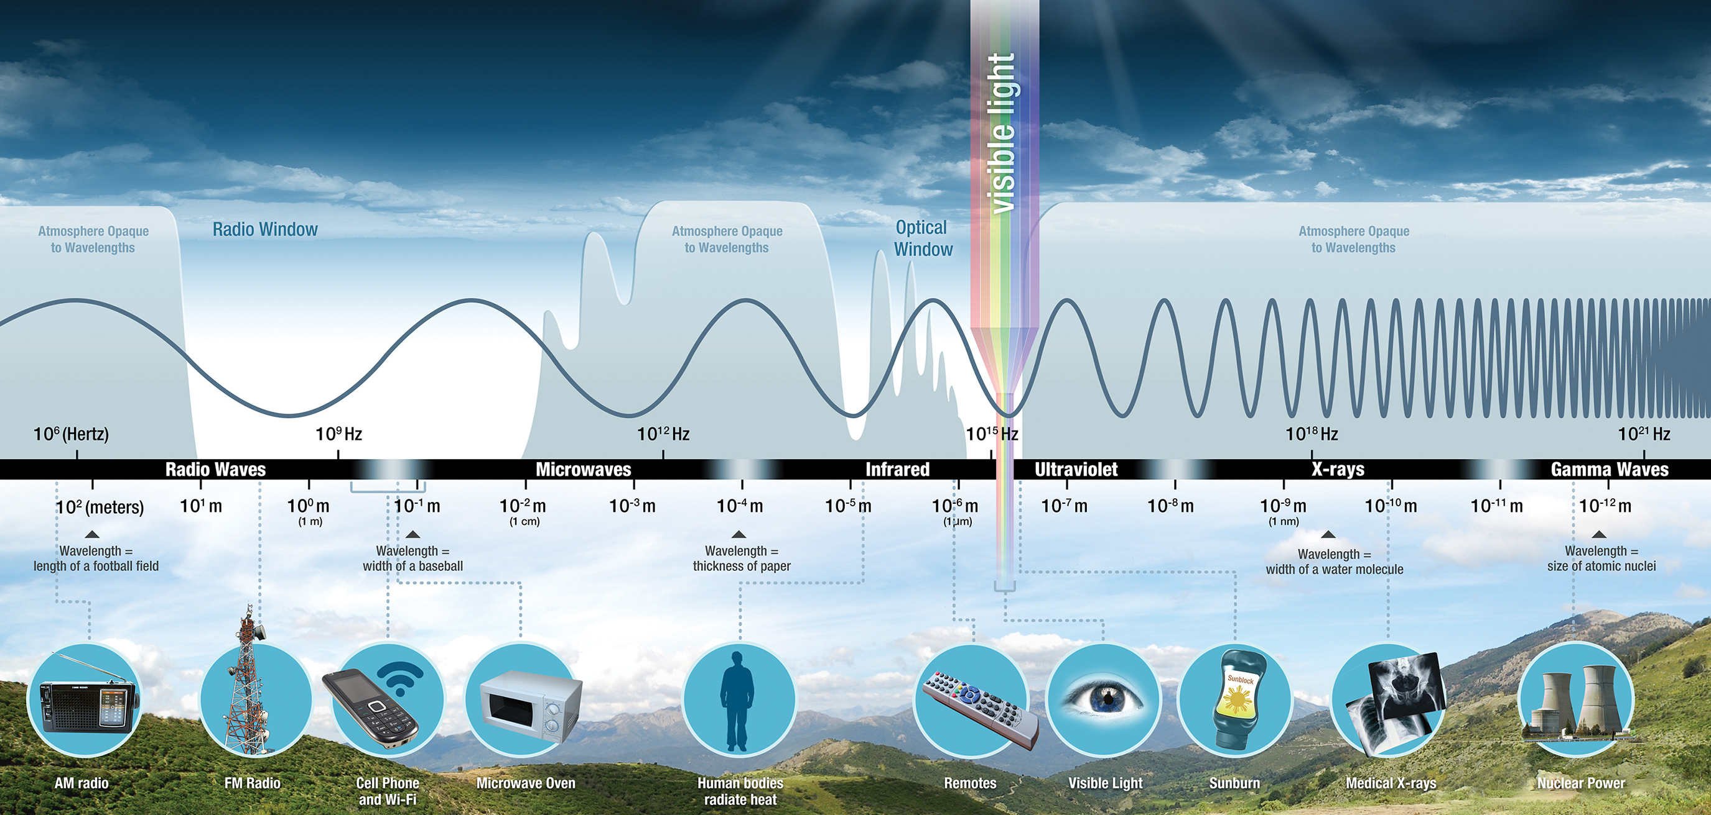
Spectral Bands Used for Land Remote Sensing
Derived from:
Reflected optical radiation
Reflected Microwave (Synthetic Aperture Radar – 300 KHz to 50 Ghz)
Notes:
Inferred indirectly from emitted Infrared radiation by clouds (Passive Remote Sensing)

Slide 6
Spectral Bands Used for Land Remote Sensing
We will focus on Land Cover from
Reflected optical radiation
Notes:
Inferred indirectly from emitted Infrared radiation by clouds (Passive Remote Sensing)

Slide 7
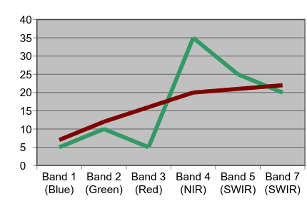
Land Cover Mapping Basics
Objects on the ground reflect electromagnetic radiation differently in different wavelengths
That is called the object’s spectral signature
Example: Green vegetation absorbs Red wavelengths but reflects NIR wavelengths
Vegetation
Percent Reflectance
Soil
Landsat Bands

Slide 8
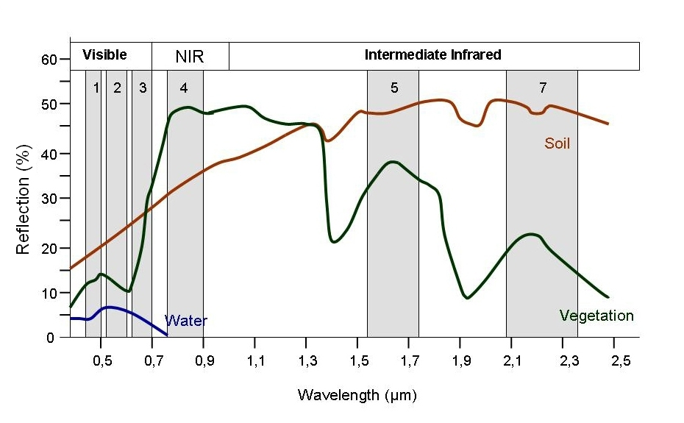
Land Cover Mapping Basics
Spectral signatures by plotting Band 3 (Red) vs. Band 4 (NIR) reflectance values:
Objects (soil, water, and vegetation) fall in different places in the plot
Special software is developed that uses this to distinguish between different land cover types
Spectral Plots
Band 3 reflectance
dry soil
water
vegetation
Band 4 reflectance

Slide 9
Spectral Signatures
There is some variation in reflectance values at different wavelengths
Depending on the land cover classes you want, the trick is to identify this variability

Slide 10
Spectral Variation
Easier: distinguishing between broad classes
e.g. vegetation and soil
Harder: distinguishing within broad classes
e.g. vegetation types
Variation within and between type (broad classes) is below
Vegetation
Soil

Slide 11
NASA Satellites and Sensors for Monitoring Land Cover

Slide 12
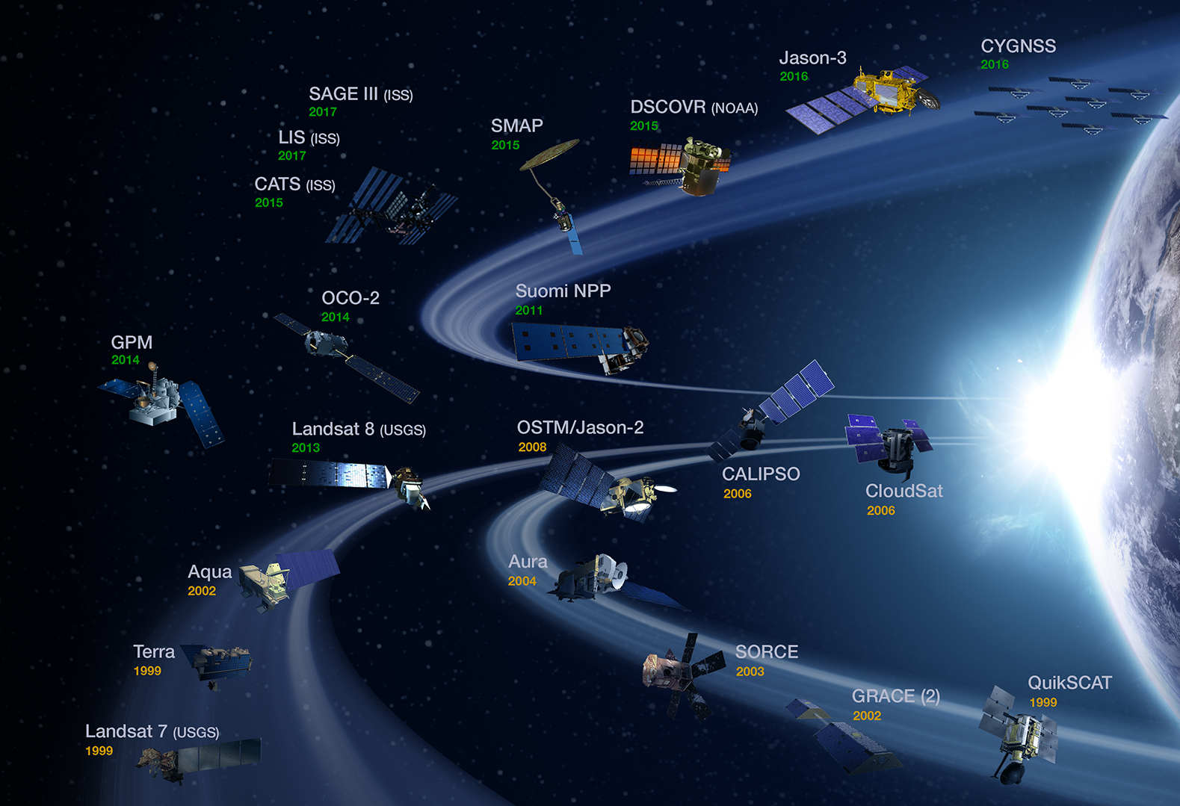
Satellites For Land Cover Monitoring
Current Satellite Missions:
Landsat 7 & Landsat 8
Terra
Aqua
Suomi National Polar Partnership (SNPP)

Slide 13
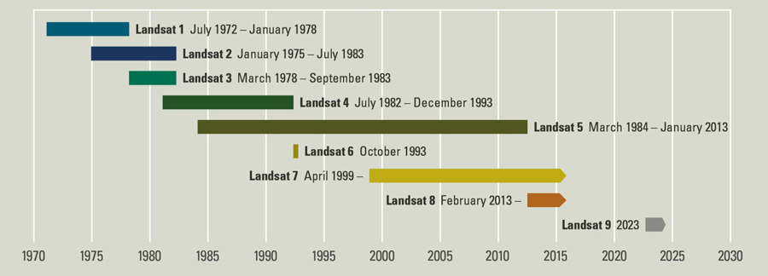
Landsat Satellites and Sensors
http://landsat.gsfc.nasa.gov/
Notes:
From: http://landsat.usgs.gov//about_mission_history.php

Slide 14
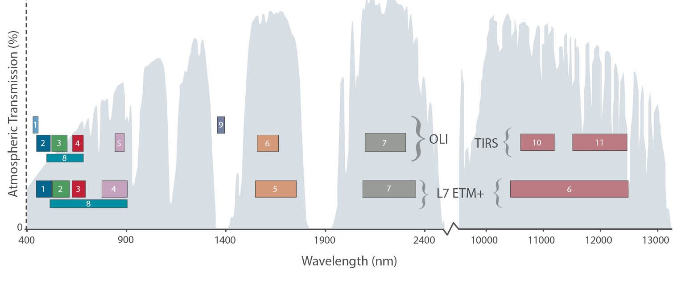
Enhanced Thematic Mapper (ETM+)
http://landsat.gsfc.nasa.gov/landsat-7/
Onboard Landsat 7
Polar orbiting satellite
Spatial Coverage and Resolution:
Global, Swath: 185 km
Spatial Resolution:
15 m, 30 m, 60 m
Temporal Coverage and Resolution:
April 15, 1999 – present
16-day revisit time
Spectral Bands: 8
Major Bands: blue-green, green, red, thermal IR, panchromatic
Bands 1-5, 7: 30 m
Band 6: 60 m
Band 8: 15 m

Slide 15
Operational Land Imager (OLI)
http://landsat.gsfc.nasa.gov/landsat-8/
Onboard Landsat 8
Polar orbiting satellite
Spatial Coverage and Resolution
Global, Swath: 185 km
Spatial Resolution: 15 m, 30 m
Temporal Coverage and Resolution:
Feb 11, 2013 – present
16-day revisit time
Spectral Bands: 9
Major Bands: blue, blue-green, red, near IR, shortwave, panchromatic
Bands 1-7, 9: 30 m
Band 8: 15 m

Slide 16
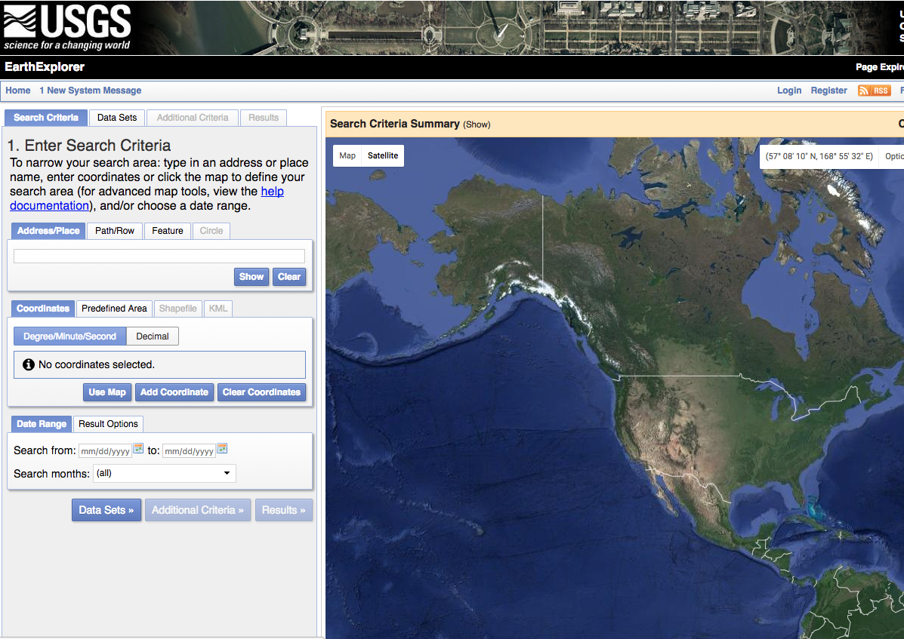
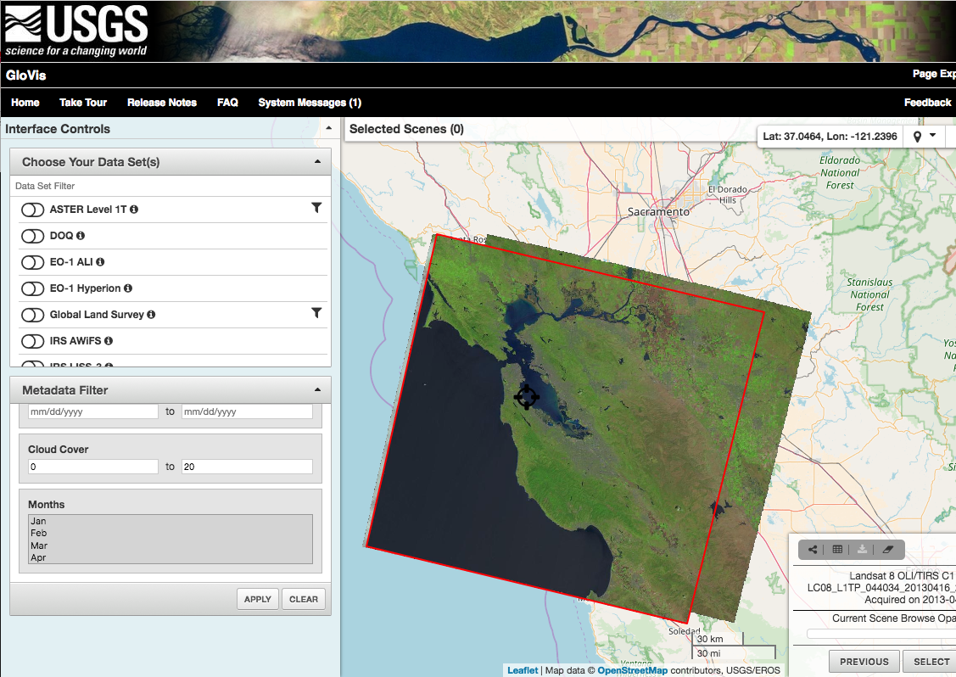
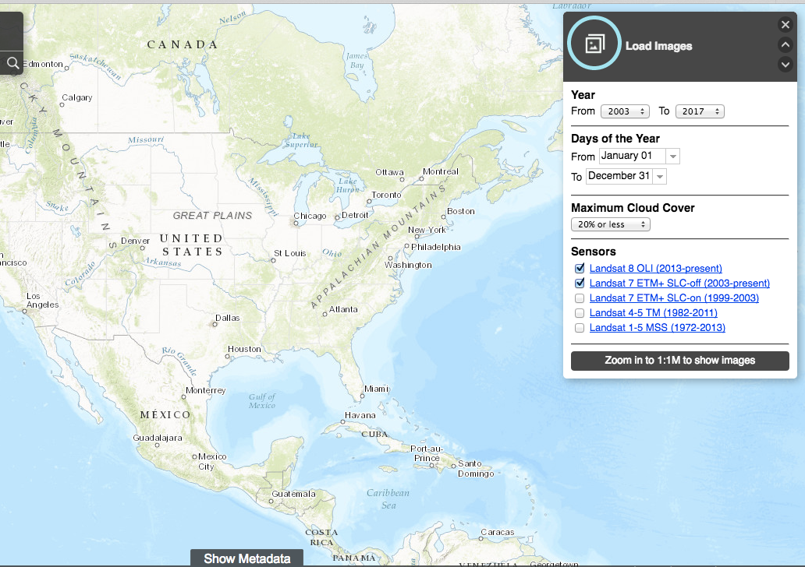
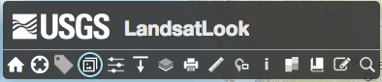
Get Landsat Images and Band Reflectance Data
Earth Explorer:
http://earthexplorer. usgs.gov/
GloVis
http://glovis.usgs.gov/
Landsat Look Viewer:
http://landsatlook.usgs.gov/

Slide 17
Terra and Aqua Satellites and Sensors
Terra
http://terra.nasa.gov
Polar orbit, 10:30 a.m. equator crossing time
Global Coverage
December 18, 1999 – Present
1-2 observations per day
Sensors:
ASTER, CERES, MISR, MODIS, MOPITT
Aqua
http://aqua.nasa.gov/
Polar orbit, 1:30 p.m. equator crossing time
Global Coverage
May 4, 2002 – Present
1-2 observations per day
Sensors:
AIRS, AMSU, CERES, MODIS, AMSR-E
Notes:
Polar orbit, 1:30 pm equator crossing time
Global Coverage
May 4, 2002 – Present
1-2 observations per day
Sensors:
AIRS, AMSU, CERES, MODIS,
AMSR-E

Slide 18
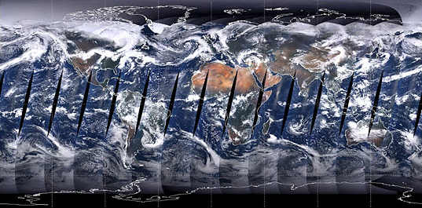
MODerate Resolution Imaging Spectroradiometer (MODIS)
http://modis.gsfc.nasa.gov/
Spatial Resolution
Global, swath: 2,330 km
250 m, 500 m, 1 km
Temporal Resolution
Daily, 8 day, 16 day, monthly, quarterly, yearly
2000 – present
Data Format
Hierarchal data format – Earth Observing System Format (HDF–EO8)
Notes:
MODIS is one of the key imaging instruments for NASA Earth Observing System (EOS). It is designed to measure large-scale global dynamics across land, oceans, and the atmosphere. Flying on two satellites allows the MODIS sensor to capture imagery of the same area on the Earth at different times of day. The two instruments are almost identical to each other and both generate daily, continuous, global, multispectral, and multi-temporal data of the Earth to build a comprehensive record of our Earth’s parameters.
Terra MODIS passes from North to South across the equator in the Morning, and Aqua MODIS passes from South to North across the equator in the afternoon. This allows MODIS to observe any location in mid-to high latitudes twice daily (one daytime pass and one night time pass).
For wildfires, MODIS is very useful due to its daily recurrence rate. Therefore, it can be used for hot spot fire detection and for smoke detection. It can also be used to track the progression of a fire on a daily basis.

Slide 19
MODerate Resolution Imaging Spectroradiometer (MODIS)
http://modis.gsfc.nasa.gov/
Spectral Coverage
36 bands (major bands include red, blue, IR, NIR, MIR)
Bands 1-2: 250 m
Bands 3-7: 500 m
Bands 8-36: 1000 m
Notes:
MODIS is one of the key imaging instruments for NASA Earth Observing System (EOS). It is designed to measure large-scale global dynamics across land, oceans, and the atmosphere. Flying on two satellites allows the MODIS sensor to capture imagery of the same area on the Earth at different times of day. The two instruments are almost identical to each other and both generate daily, continuous, global, multispectral, and multi-temporal data of the Earth to build a comprehensive record of our Earth’s parameters.
Terra MODIS passes from North to South across the equator in the Morning, and Aqua MODIS passes from South to North across the equator in the afternoon. This allows MODIS to observe any location in mid-to high latitudes twice daily (one daytime pass and one night time pass).
For wildfires, MODIS is very useful due to its daily recurrence rate. Therefore, it can be used for hot spot fire detection and for smoke detection. It can also be used to track the progression of a fire on a daily basis.

Slide 20
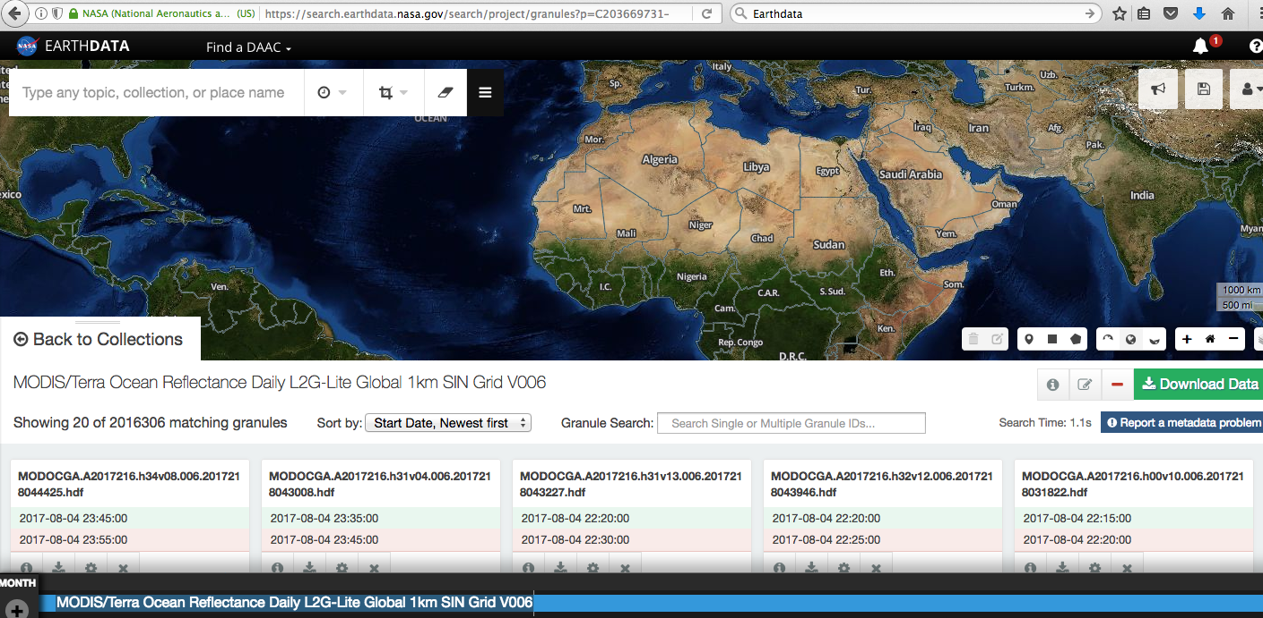
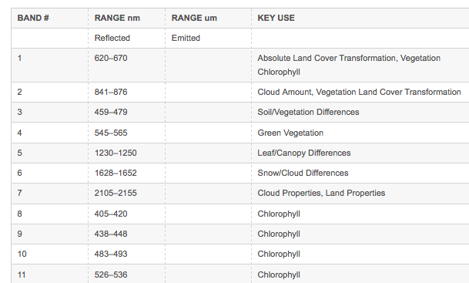
Get MODIS Band Reflectance Data
Land Processing Distributed Active Archive Center
http://lpdaac.usgs.gov/dataset_discovery/modis/modis_products_table/
NASA Earthdata
http://earthdata.nasa.gov/

Slide 21
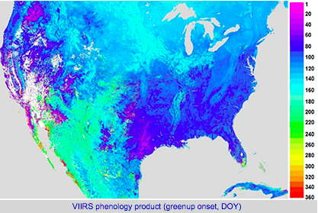
Visible Infrared Imaging Radiometer Suite (VIIRS)
http://jointmission.gsfc.nasa.gov/viirs.html
Onboard Suomi NPP
Polar orbiting satellite
Functionality similar to MODIS
Spatial Coverage and Resolution:
Global, Swath Width: 3,040 km
Spatial Resolution: 375 – 750 m
Temporal Coverage and Resolution:
Oct 2011 – present
1-2 times per day

Slide 22
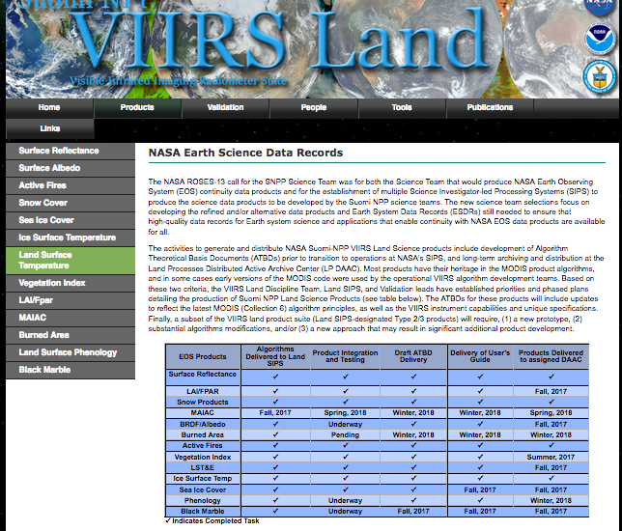
Get VIIRS Band Reflectance Data and Land Products Data
Land Process Distributed Active Archive Center
https://lpdaac.usgs.gov/dataset_discovery/viirs/viirs_products_ table

Slide 23
Example: Satellite Image Classification for Land Cover
Requires delineating boundaries of classes in n-dimensional space using class statistics
Each group of pixels is characterized by:
min.
max.
mean
standard deviation
All the pixels in the image that fall within those statistics are given those labels
Vegetation
Soil

Slide 24
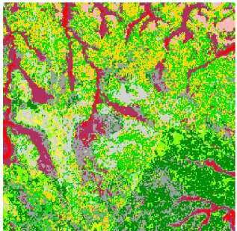
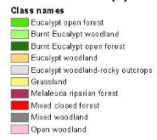
Image Classification: Approaches
Pixel-Based
Each pixel is grouped in a class
Useful for multiple changes in land use within a short period of time
Best for complete data coverage and a need for methods to ensure time series consistency at the pixel level
Whiteside, T., & Ahmad, W. (2005, September). A comparison of object-oriented and pixel-based classification methods for mapping land cover in northern Australia. Proceedings of SSC2005 Spatial intelligence, innovation and praxis: The national biennial Conference of the Spatial Sciences Institute.
Notes:
There are many different ways to classify imagery but almost all can be categorized into two approaches: pixel based and object based. In pixel based approaches, each pixel is grouped into a spectrally similar class. These approaches are most useful where there are multiple changes in land use within a short period of time, and they are best suited when there is wall to wall data coverage and time series consistency at the pixel level is required.
Object-based approaches partitions an image into groups of pixels that are spectrally similar and spatially adjacent. Boundaries of pixel groups delineate ground objects in much the same way a human analyst would do based on its shape, tone, and texture. This process is called segmentation. These kinds of images can be easier for an analyst to interpret. This approach is also used on radar imagery to reduce speckle. It is especially useful for high spatial resolution imagery because pixel-based approaches tend to be very noisy.
The images below show the visual differences between the two approaches. On the right is the pixel based approach and on the right, you can see the same image that has been segmented and classified. It produces a much smoother image.
http://www.ecognition.com/sites/default/files/273_0168.pdf
Image segmentation is the process of partitioning an image into groups of pixels that are spectrally similar and spatially adjacent

Slide 25
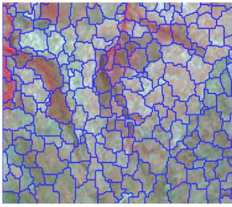
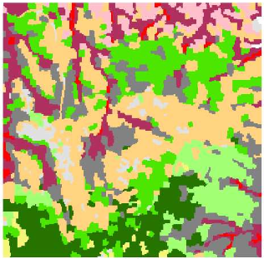
Image Classification: Approaches
Object-Based
Pixels with common spectral characteristics are first grouped together (segmentation)
Useful for:
reducing speckle noise in radar images
high resolution imagery
Whiteside, T., & Ahmad, W. (2005, September). A comparison of object-oriented and pixel-based classification methods for mapping land cover in northern Australia. Proceedings of SSC2005 Spatial intelligence, innovation and praxis: The national biennial Conference of the Spatial Sciences Institute.
Notes:
There are many different ways to classify imagery but almost all can be categorized into two approaches: pixel based and object based. In pixel based approaches, each pixel is grouped into a spectrally similar class. These approaches are most useful where there are multiple changes in land use within a short period of time, and they are best suited when there is wall to wall data coverage and time series consistency at the pixel level is required.
Object-based approaches partitions an image into groups of pixels that are spectrally similar and spatially adjacent. Boundaries of pixel groups delineate ground objects in much the same way a human analyst would do based on its shape, tone, and texture. This process is called segmentation. These kinds of images can be easier for an analyst to interpret. This approach is also used on radar imagery to reduce speckle. It is especially useful for high spatial resolution imagery because pixel-based approaches tend to be very noisy.
The images below show the visual differences between the two approaches. On the right is the pixel based approach and on the right, you can see the same image that has been segmented and classified. It produces a much smoother image.
http://www.ecognition.com/sites/default/files/273_0168.pdf
Image segmentation is the process of partitioning an image into groups of pixels that are spectrally similar and spatially adjacent

Slide 26
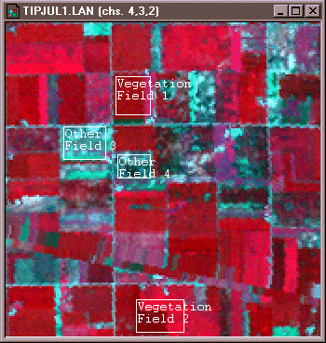
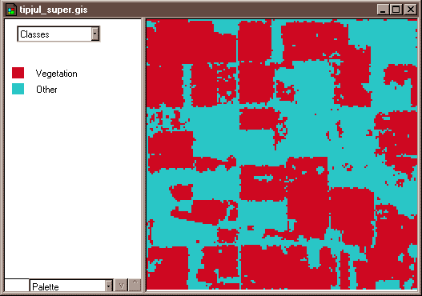
Satellite Image Classification: Methods
Supervised
Uses expert-defined areas of known veg. types to tune parameters of classification algorithms
Algorithm then automatically identifies and labels areas similar to the training data
Credit: David DiBiase, Penn State Department of Geography
Notes:
Two different methods are typically used to create land cover maps. The supervised method can use either a pixel-based approach or an object-based approach. The unsupervised method uses a pixel-based approach. The supervised method uses user-defined areas of known land cover types that are called training areas. These areas are then used to define the statistical parameters of classification algorithms. The algorithm then automatically identifies and labels all pixels or segments that are statistically similar to the training data.
In the unsupervised method, a classification algorithm assigns each pixel into one of a number of user-specified classes. Then interpreters assign each of the pixel groupings a value corresponding to a land cover class.
I’m going to describe to you a little more about the supervised approach.
https://www.e-education.psu.edu/natureofgeoinfo/c8_p18.html

Slide 27
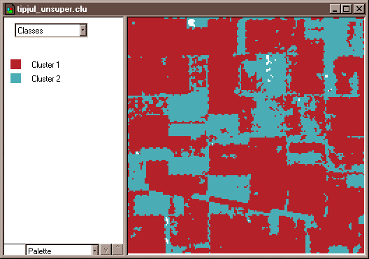
Satellite Image Classification: Methods
Unsupervised
Uses classification algorithms to assign pixels into one of a number of user-specified class groupings
Interpreters assign each of the groupings of pixels a value corresponding to a land cover class
Credit: David DiBiase, Penn State Department of Geography
Notes:
Two different methods are typically used to create land cover maps. The supervised method can use either a pixel-based approach or an object-based approach. The unsupervised method uses a pixel-based approach. The supervised method uses user-defined areas of known land cover types that are called training areas. These areas are then used to define the statistical parameters of classification algorithms. The algorithm then automatically identifies and labels all pixels or segments that are statistically similar to the training data.
In the unsupervised method, a classification algorithm assigns each pixel into one of a number of user-specified classes. Then interpreters assign each of the pixel groupings a value corresponding to a land cover class.
I’m going to describe to you a little more about the supervised approach.
https://www.e-education.psu.edu/natureofgeoinfo/c8_p18.html

Slide 28
QGIS: Semi-Automatic Classification Plugin (SCP)
Developed by Luca Congedo
Free, open-source plugin for QGIS that allows for supervised classification
It provides:
Several tools for the download of imagery
Preprocessing (Digital Numbers to Top of Atmosphere Reflectance)
Training site selection and analysis
Classification algorithms
Documentation: Congedo, Luca (2016). Semi-Automatic Classification Plugin Documentation.
https://fromgistors.blogspot.com/p/semi-automatic-classification-plugin.html
See ARSET Land Cover Classification webinar for details:
http://arset.gsfc.nasa.gov/land/ webinars/advanced-land-classification

Slide 29
Land Cover Datasets

Slide 30
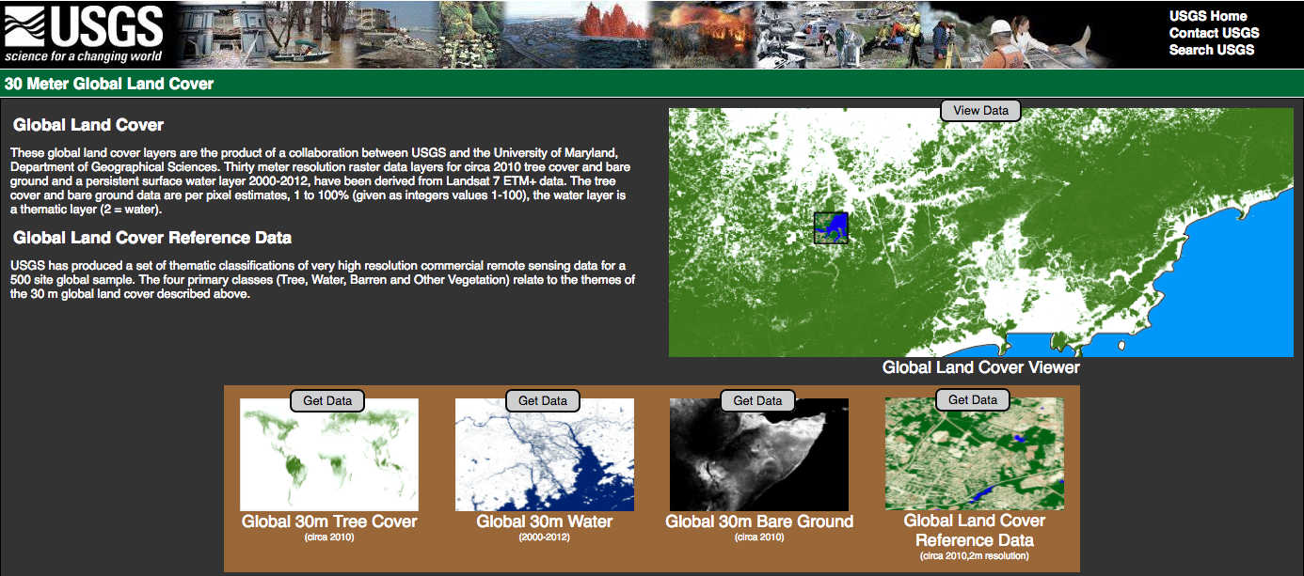
Landsat Land Cover Data
https://landcover.usgs.gov/glc/

Slide 31
Landsat Land Cover
https://landcover.usgs.gov/glc/
Based on Landsat 7 ETM+ composites, cloud free images from 2000-2012
Four Classes: Tree Cover, Water, Bare Ground, and Other Vegetation
Spatial Resolution of 30 m
Tree Cover and Bare Ground/Other Vegetation represent 2010 values
Reference Land Cover Data available based on high resolution commercial satellites for 500 global sites

Slide 32
Landsat Land Cover
https://landcover.usgs.gov/glc/
Data gaps filled by multi-year median
Data represent peak of growing season (maximum tree cover-minimum bare ground) in per cent
Permanent Water Surfaces derived from 2000-2012 growing season composites
Data available in 10°x10° tiles

Slide 33
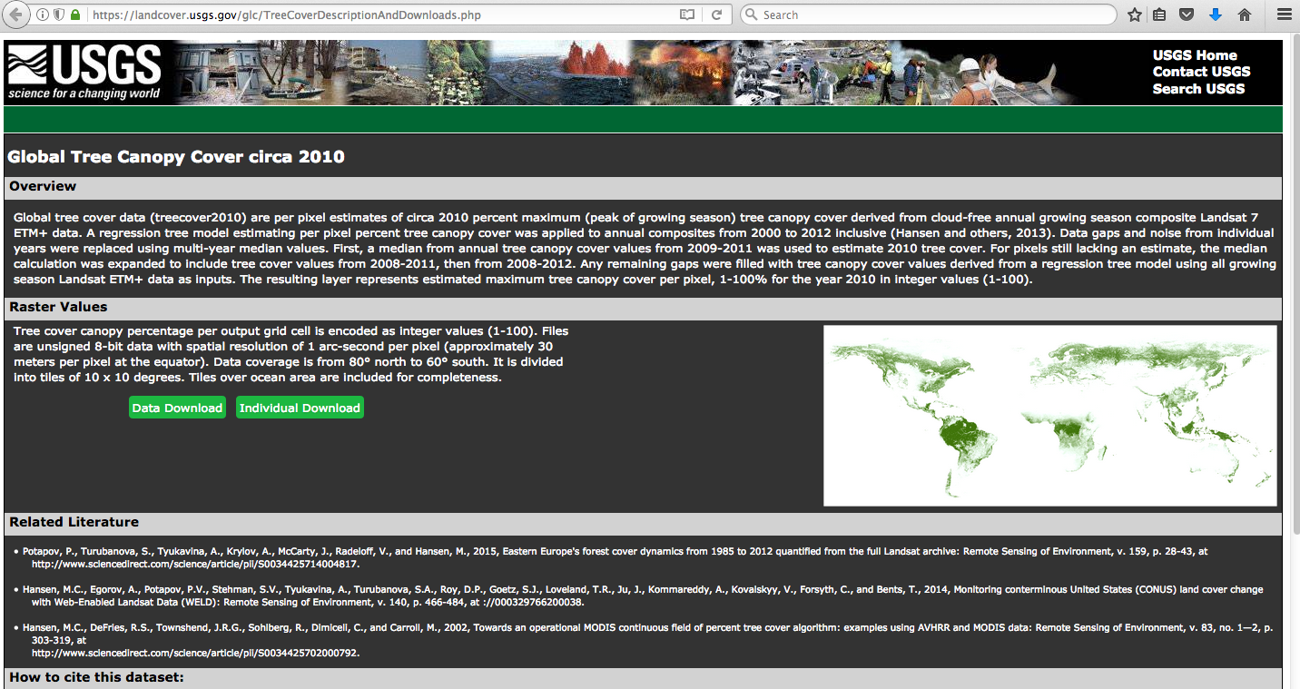
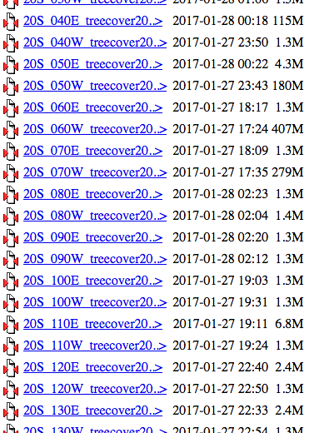
Landsat Land Cover Data Access
https://landcover.usgs.gov/glc/
List of Tiles by Lat-Lon
Download Individual Tile or All Tiles
Click to download data for individual tile in GeoTIFF format

Slide 34
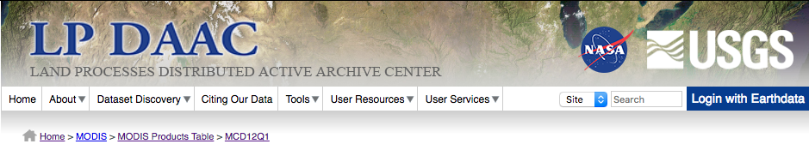
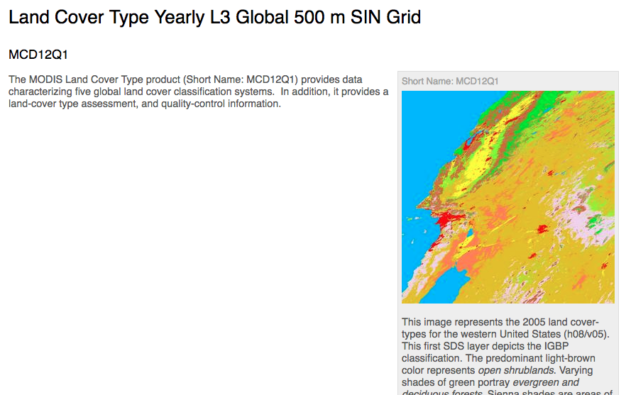
MODIS Land Cover Data (Product Name: MCD12Q1)
https://lpdaac.usgs.gov/dataset_discovery/modis/modis_products_table/mcd12q1
Annual Composites from Terra and Aqua MODIS
Spatial resolution: 500 meter
Primary Land Cover Type Scheme: International Geosphere Biosphere Program (IGBP) global vegetation classification scheme
11 vegetation classes
3 developed classes
3 non-vegetated classes

Slide 35
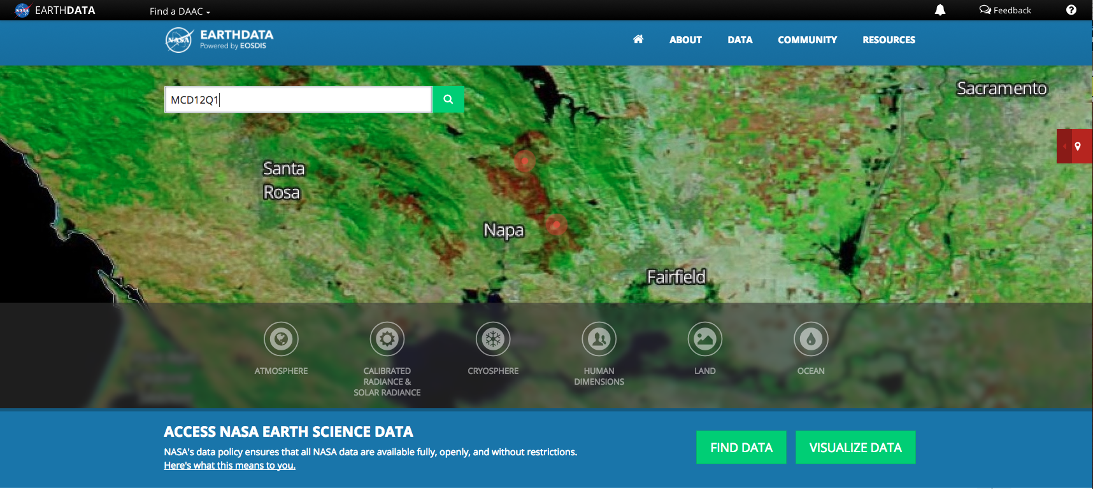
MODIS Land Cover Data Search
https://earthdata.nasa.gov/

Slide 36
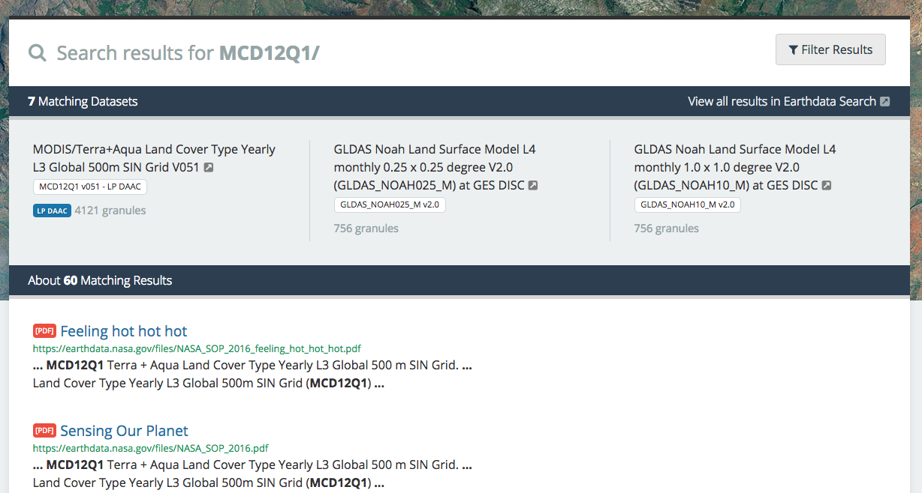
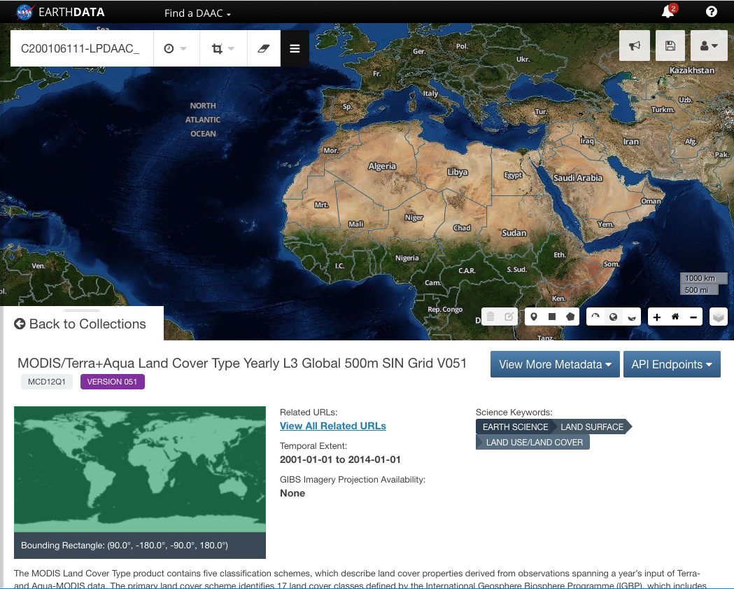
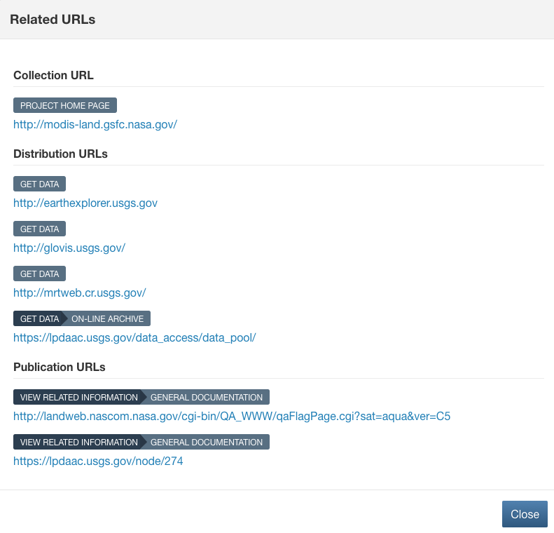
MODIS Land Cover Data Access
https://earthdata.nasa.gov/search?q=MCD12Q1/

Slide 37
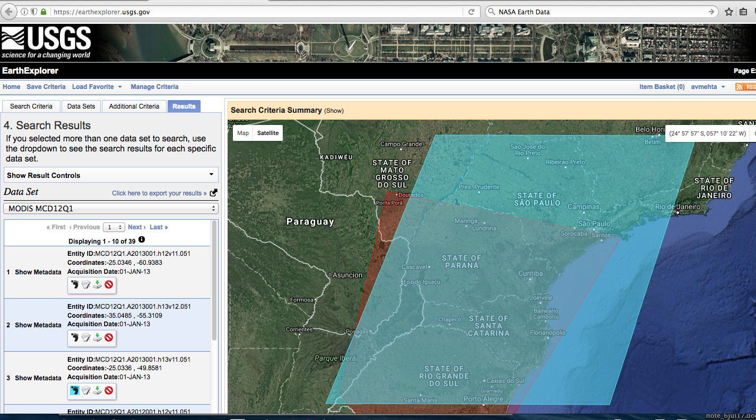
MODIS Land Cover Data Download
https://earthexplorer.usgs.gov/
Data Download in sinusoidal grid, in HDF Format
Software available from LPDAAC for re-projection and conversion to NetCDF or GeoTiff
https://lpdaac.usgs.gov/tools/modis_reprojection_tool

Slide 38
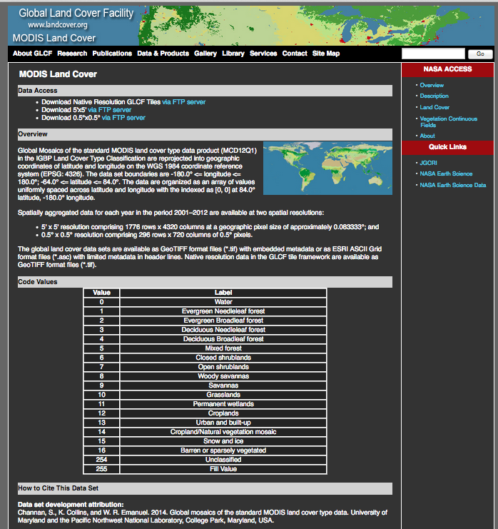
MODIS Land Cover Data Download
http://glcf.umd.edu/data/lc/
Available from Global Land Cover Facility
Also available in .tiff format at 0.0833° and 0.5° resolutions

Slide 39
MODIS NDVI

Slide 40
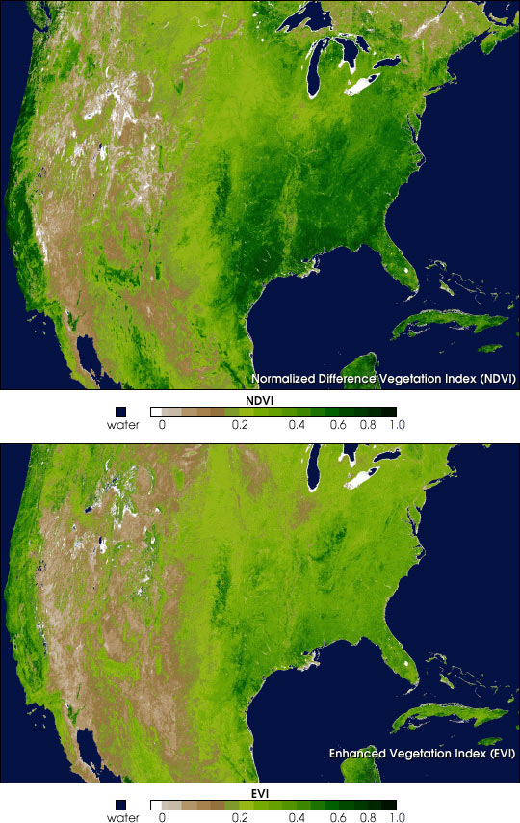
MODIS Vegetation Indices Product Overview
Vegetation Indices:
NDVI (Normalized Difference Vegetation Index)
16 day, 250 meter spatial resolution as a gridded level 3 product
Used for characterizing land surface processes
Anomalies can be used to identify drought
EVI (Enhanced Vegetation Index)
Minimizes canopy background
Improvement in dense vegetation conditions
Notes:
NDVI:
The Enhanced Vegetation Index, or EVI, is another vegetation index available as a standard product from the MODIS sensor. The NDVI is more chlorophyll sensitive while the EVI is more responsive to canopy structural variations, including Leaf Area Index and canopy type. One problem with the NDVI is that it saturates over high biomass areas. The EVI was developed to optimize the vegetation signal with improved sensitivity in high biomass regions and a reduction in atmospheric influences

Slide 41
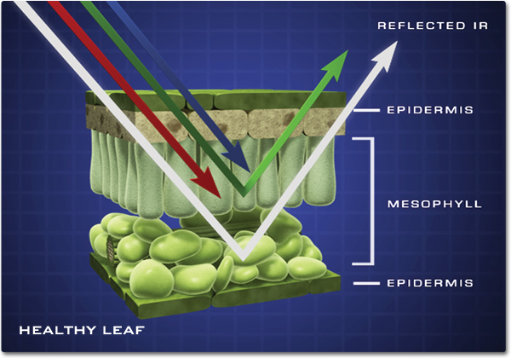
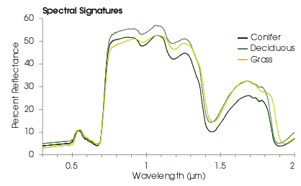
What is NDVI?
Normalized Difference Vegetation Index
Based on the relationship between red and near-infrared wavelengths
Chlorophyll strongly absorbs visible (red)
Plant structure strongly reflects near-infrared
Red
Near-Infrared
Notes:
As you recall, when sunlight strikes plant leaves the chlorophyll in those leaves strongly absorbs visible light (blue and red), and the cell structure of the leaves reflects green, and strongly reflects near-infrared light. This is portrayed in this graphic on the top as well as the graph. The two key wavelengths for NDVI are the Red and Near-infrared. In the graph you can see where the red is being absorbed (low reflectance) and the near-infrared is highly reflective.

Slide 42
What is NDVI?
NDVI formula:
Values range from -1.0 to 1.0
Negative values to 0 mean no green leaves
Values close to 1 indicate the highest possible density of green leaves
Near Infrared - Red
Near Infrared + Red
Notes:
NDVI is the relationship between the Red and the Near-Infrared wavelengths. The actual formula is specified here.
The values of NDVI for an individual pixel range from -1 to 1. Any pixel between -1 and 0 means no vegetation and pixels close to 1 indicates the highest possible density of green leaves.
The picture on the right shows that healthy green vegetation absorbs most of the visible light (only 8% is reflected) and reflects a large portion of the near-infrared light (50% is reflected). Unhealthy, sparse or senescing vegetation reflects more visible light (30% is reflected) and less near-infrared light (40% is reflected). You can see the difference in the resulting NDVI values below the image. The green vegetation has a value closer to 1, while the brown vegetation has a value closer to 0.

Slide 43
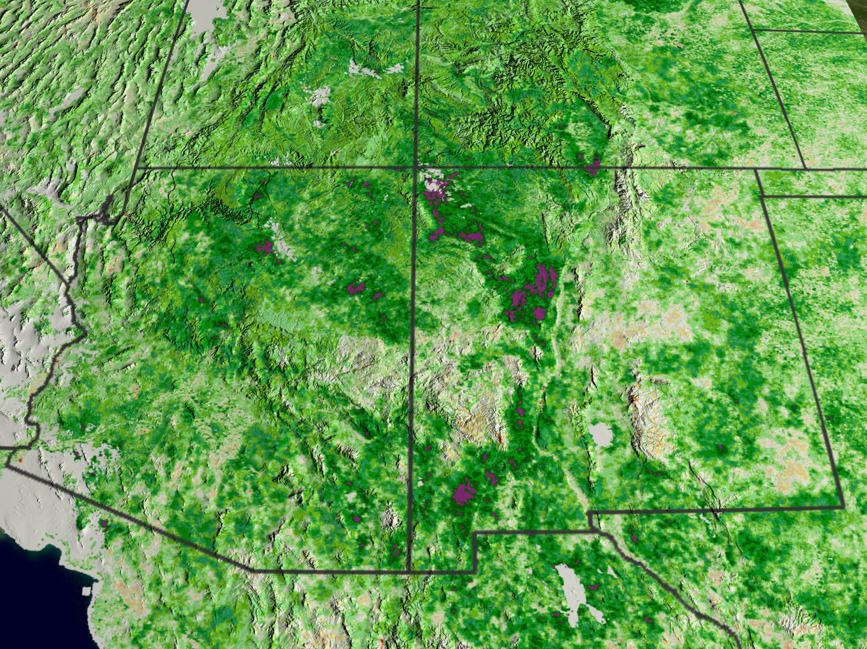
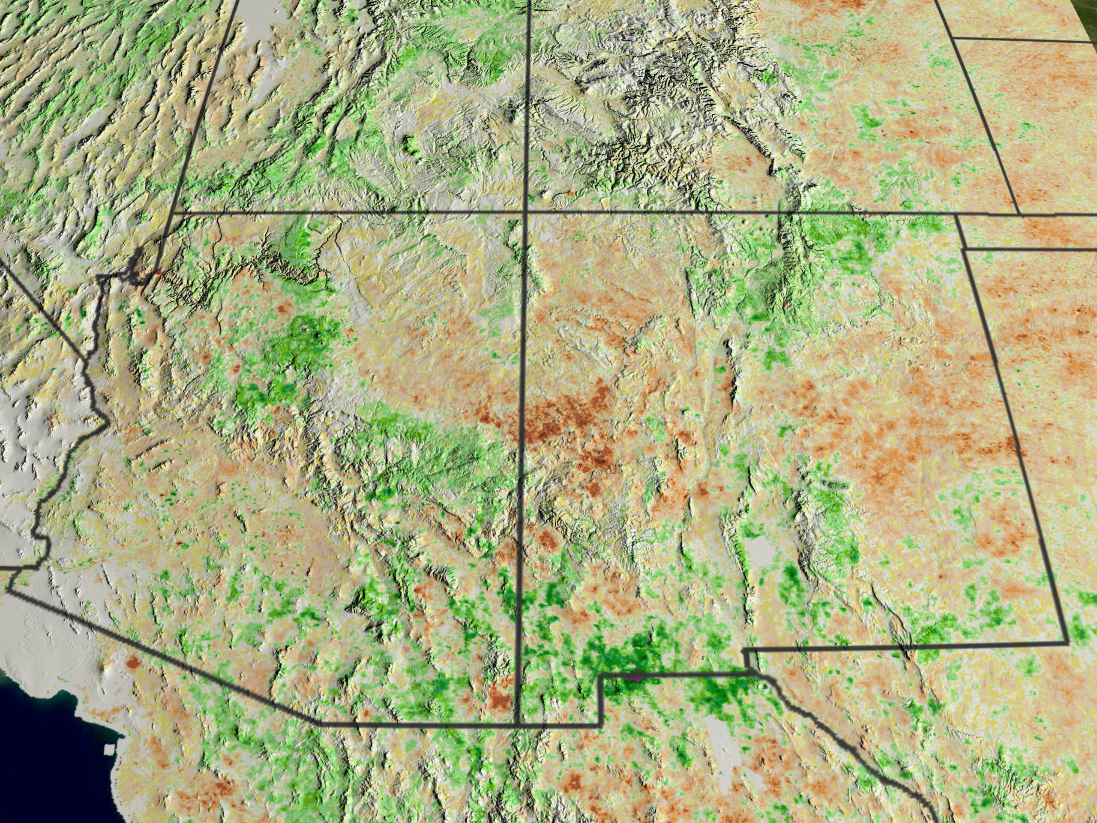
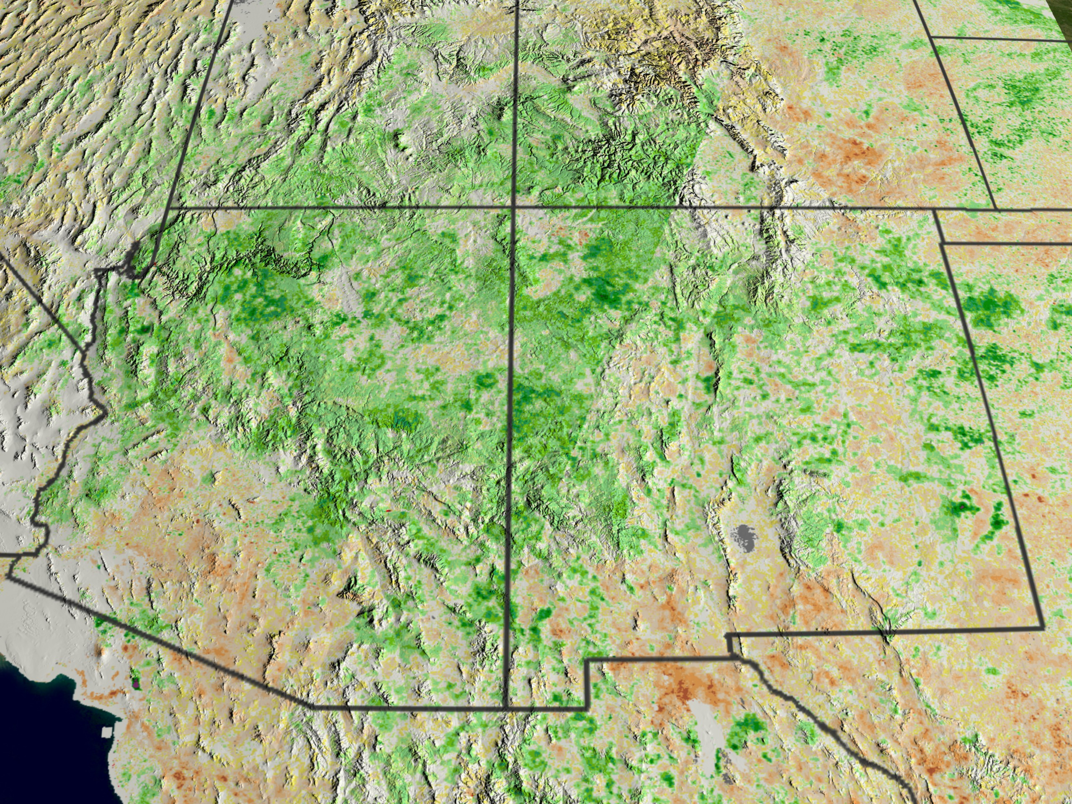
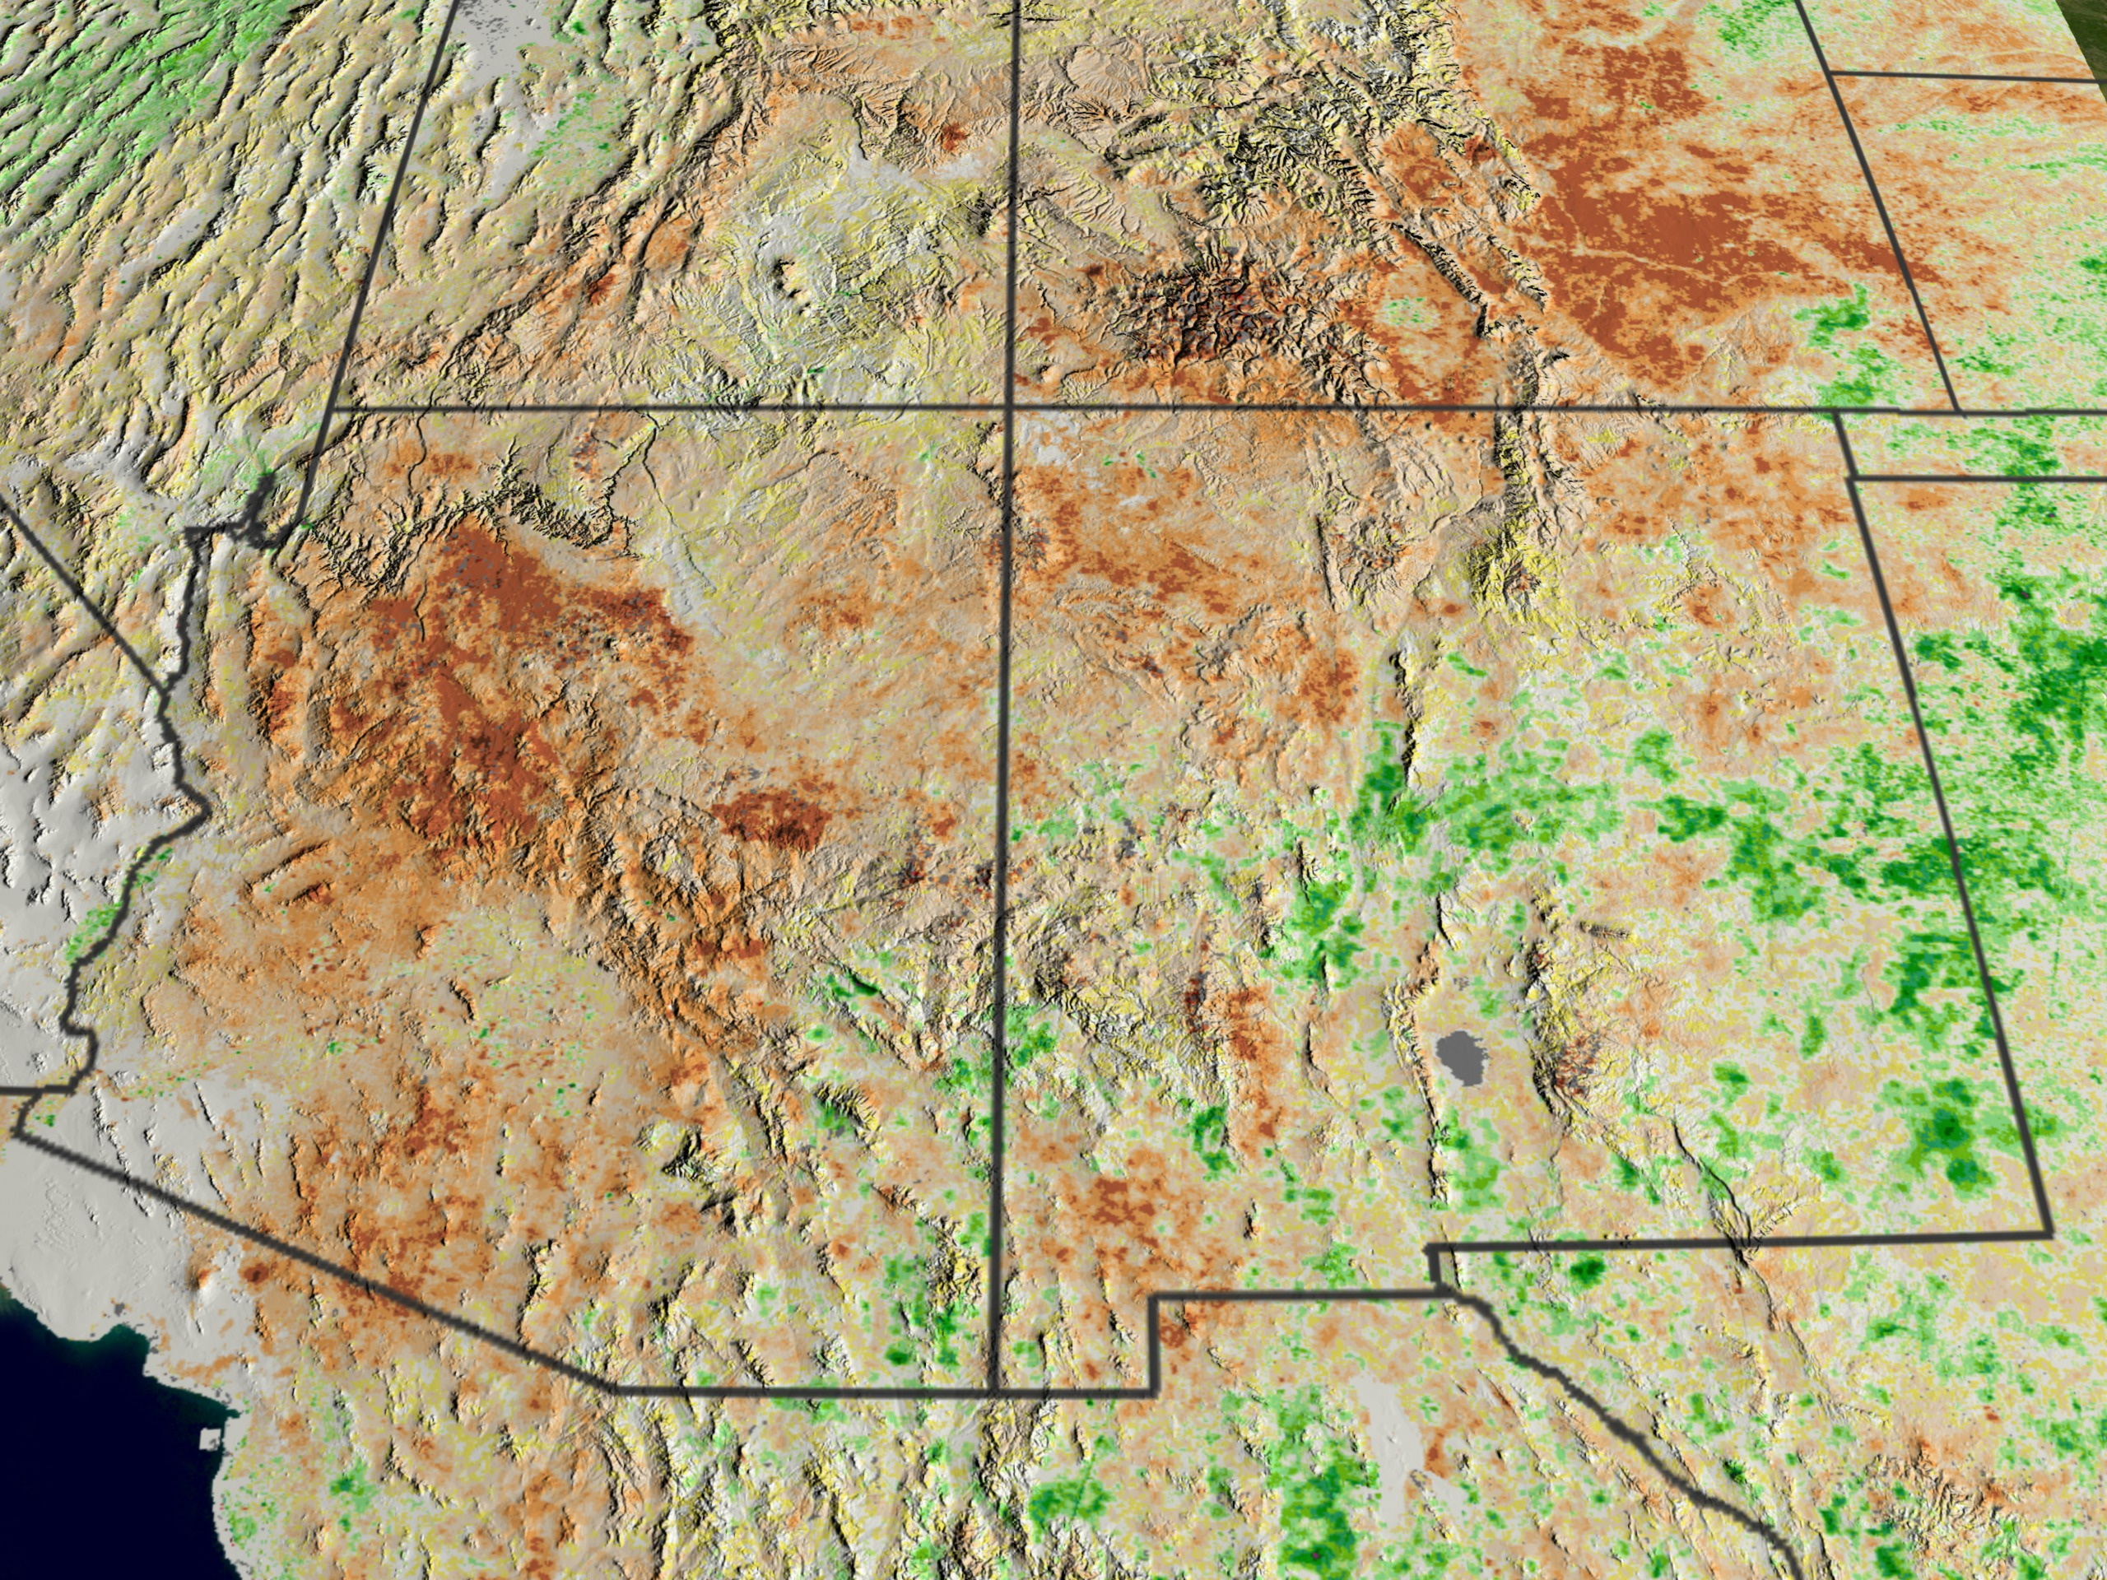
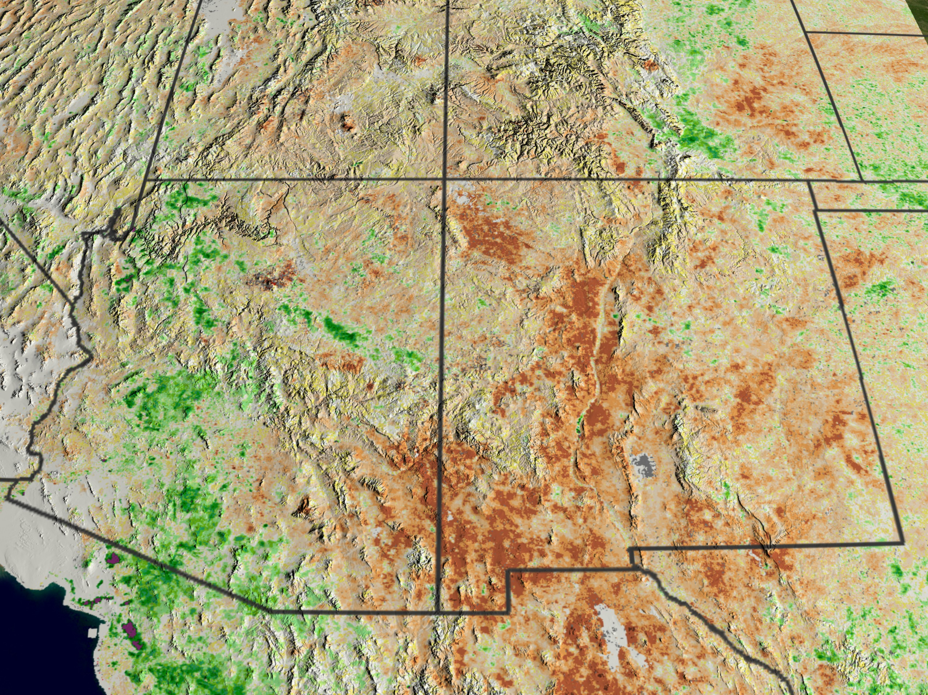
NDVI Anomalies
Departure of NDVI from the long-term average, normalized by long-term variability
Generated by subtracting the long-term mean from the current value for that month of the year for each grid cell.
Indicates if vegetation greenness at a particular location is typical for that period or if the vegetation is more or less green
Aug 1999
Aug 2000
Aug 2001
Aug 2002
Aug 2003
NDVI Anomalies in the Southwestern United States
Notes:
NDVI anomalies are often use to show current vegetation patterns relative to the long term averages. This can be calculated by subtracting the long-term mean from the current value and is often done on a monthly basis. For example, if the anomaly is negative, this indicates that the vegetation is less green than normal which may be indicative of drought-like conditions. The brown areas in these pictures show negative anomalies for the years specified.

Slide 44
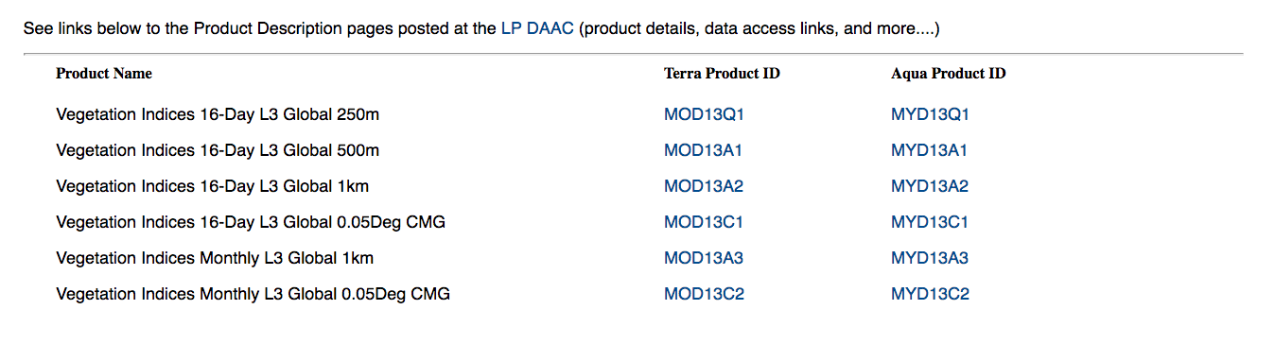
MODIS Vegetation Indices
http://modis-land.gsfc.nasa.gov/vi.html

Slide 45
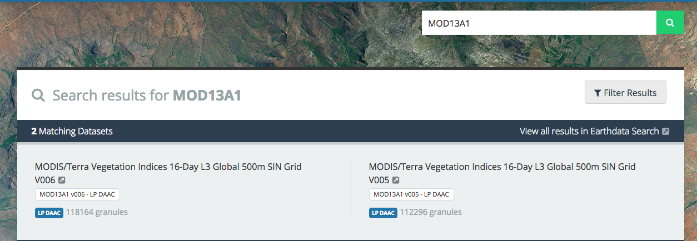
MODIS NDVI Data Search and Access
https://earthdata.nasa.gov/search?q=MOD13A1
Search
Access

Slide 46
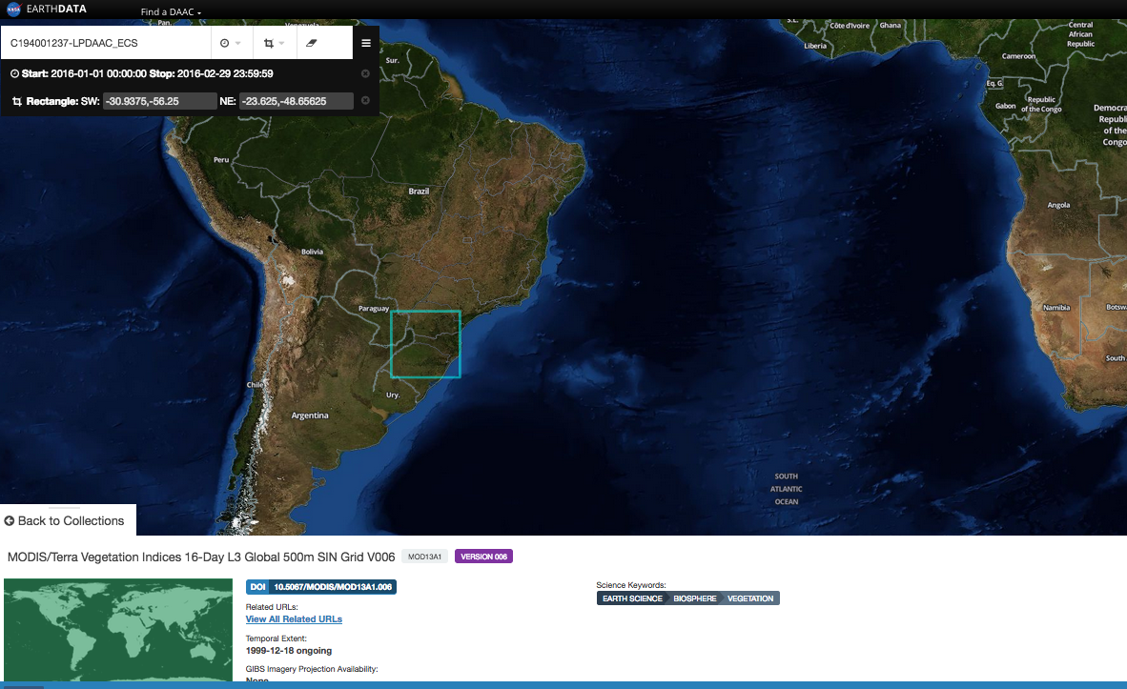
MODIS NDVI Data Download
Temporal & Spatial Search

Slide 47
Next: Access Landsat Land Cover for SFW and Analyze MODIS NDVI over SFW

